Slide 1
Rotary Kiln Data Acquisition and Controls Upgrade
Bringing Zircoa into the 20th Century.
…Just not the 21st Century

Slide 2
Project Goals
Primary Goal (Core Project Driver):
Improve operational consistency of the rotary kiln.
Secondary Goals (Critical Project Elements):
Increase internal knowledge of rotary kiln controls, and control systems in general.
Thoroughly understand & document process.
Build a robust knowledge base (prevent point-person dependence).
Exploratory Goals (Potential Gains/Improvements Uncovered During Project):
Increase operational flow rate.
Increase process reaction yield.
Reduce/eliminate clinker rings in the kiln.
Reduce kiln brick degradation.

Slide 3
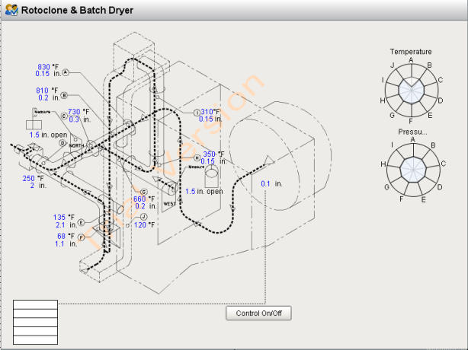
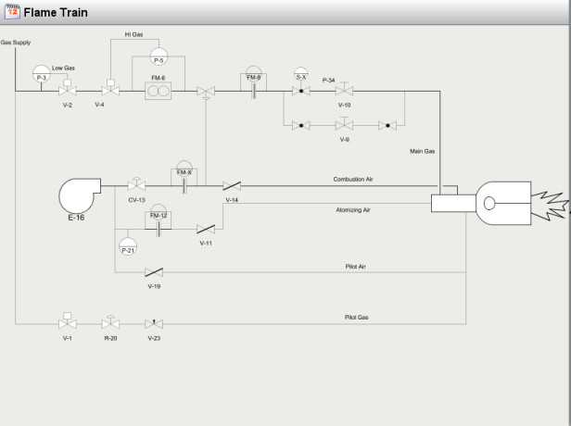
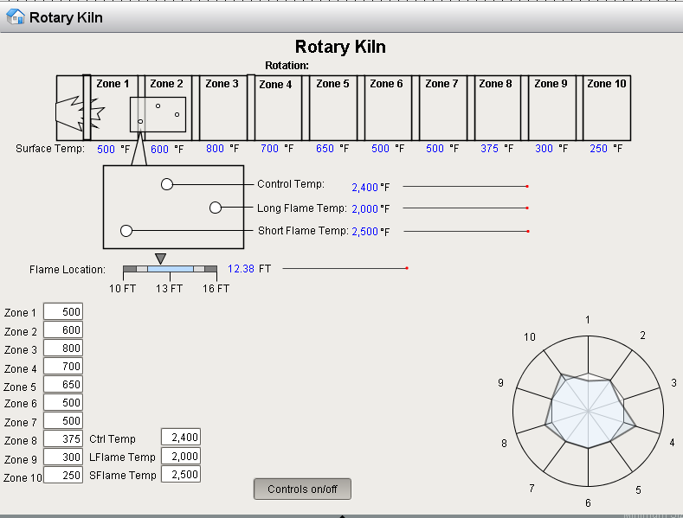
Full Project Scope
Three Phase Project:
Phase One: Dusthouse/Dryer/Rotoclone
Build Pressure & Heat Controls
The Focus of this Meeting
Phase Two: Flame Train System Upgrade
Highlight alarms in process & flow meters for fuel optimization.
Phase Three: Kiln Temperature Profiling
Monitor short/long flame & steady state kiln temp profile

Slide 4
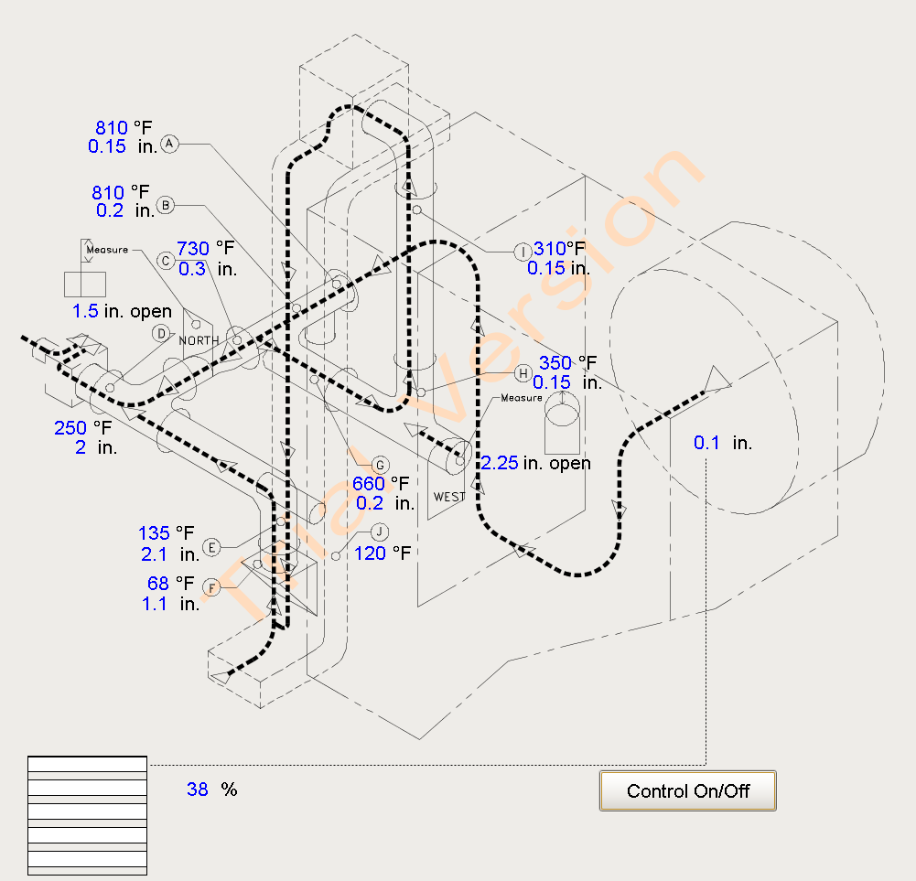
First Phase Expanded Scope
Implement new control system to replace old, non-functioning pneumatic controller.
Replace broken manual temperature and pressure gauges with digital indicators.
Experiment with effects of process changes utilizing new indicators.
Build controls for dryer system based on experimentation.

